Slide 1
MAT 350
Engineering mathematics
System of First order ODEs:
Non-homogeneous
Lecture: 11 B
Dr. M. Sahadet Hossain (Mth)
Professor
Department of Mathematics and Physics, NSU.

Slide 2
NON-HOMOGENEOUS LINEAR SYSTEM of ODEs
The general solution of a nonhomogeneous linear
system
The methods of undetermined coefficient and variation of parameters are used to find the particular solutions of nonhomogeneous linear ODEs. We only focus on of undetermined coefficient.

Slide 3
NON-HOMOGENEOUS LINEAR SYSTEM of ODEs
Two Methods:
Undetermined Coefficients
Variation of Parameters

Slide 4
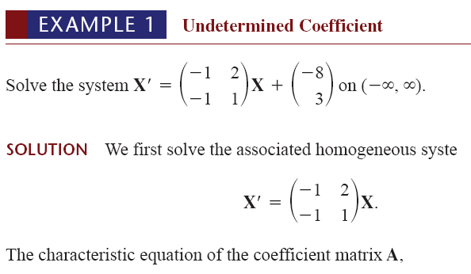

UNDETERMINED COEFFICIENTS

Slide 5



Note that α= 0, and β=1
Now since F(t) is a constant vector, we assume a constant
particular solution vector
Substituting this latter assumption into the original system and equating entries leads to

Slide 6




Slide 7
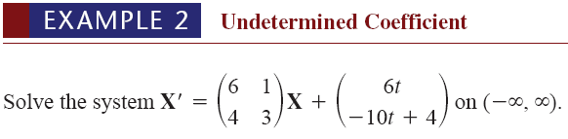
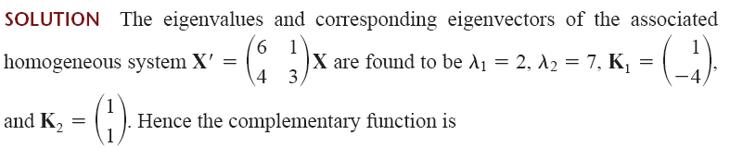





Slide 8
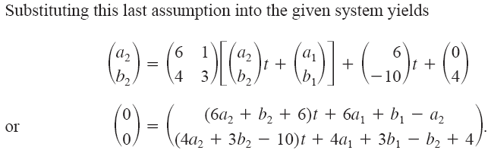
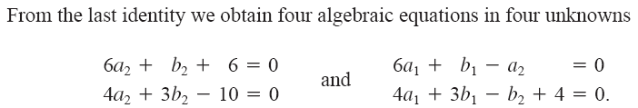

Slide 9

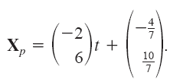
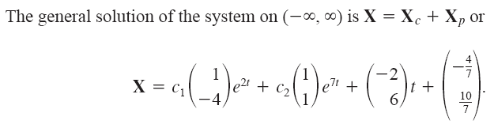


Slide 10

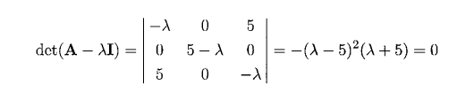




Slide 11




Slide 12
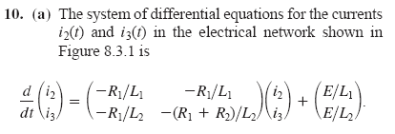
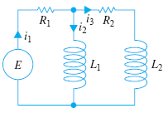


Slide 13
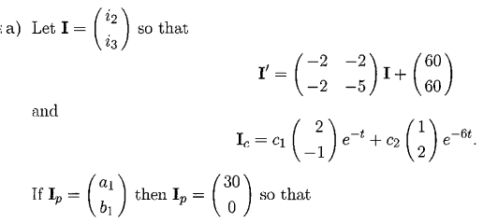




Slide 18
Xc
Xp

Slide 19
(1)
Solution:
First we solve the associated linear homogeneous system
(2)
Find eigenvalues:
Find eigenvectors corresponding to $λ_{1}=−2 and{ λ}_{2}=−2, respectively$
(2) is
Hence, Fundamental matrix is

Slide 20


Notes:

Slide 22
Exercise: 8.3
Prob#15
Hints

Slide 23
Prob#18
Hints

Slide 24
Prob#24
Hints

Slide 25
Hints

Slide 26
X=Xc+Xp=
+

Slide 28
Hints

Slide 29
Problems for Assignments:
Exercise 8.3, Problem# 24, 30, 33

